Slide 1

Promoting Cycling in London: Data-informed Recommendations
TEAM CLOUD 9
Monday 20th November 2023
Notes:
JAMES: Hello everyone, we’re Cloud 9, immersing ourselves in London’s cycling scene. Our mission is to utilise data analysis to enhance cycling experience and contribute to a greener and more sustainable London. So, let’s dig into the data and uncover some practical insights together.

Slide 2
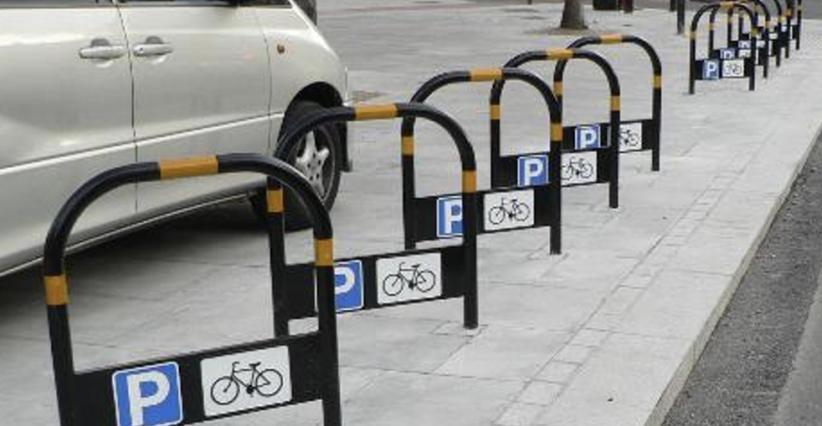

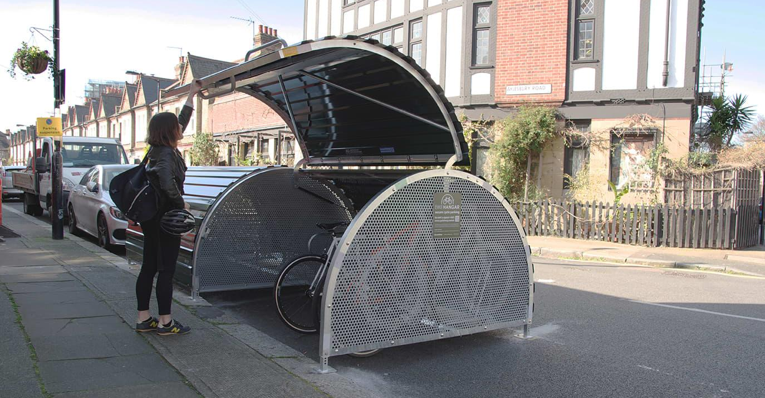
Our Analysis
Infrastructure
Demographics
Weather
> Bike Parking
> Road signage & cycling
Safety
> Cycle Superhighway &
Quietway
> Cycle Hire Scheme
> Gender disparity in
Cycling
> Gender time distribution
during a weekday
> Dry
> Wet
Images taken from Cycling Infrastructure Database’s Asset Information Guide
Notes:
James: We will cover our analysis from three angles, namely Infrastructure, Demographics and Weather. We will first look at Infrastructure.

Slide 3
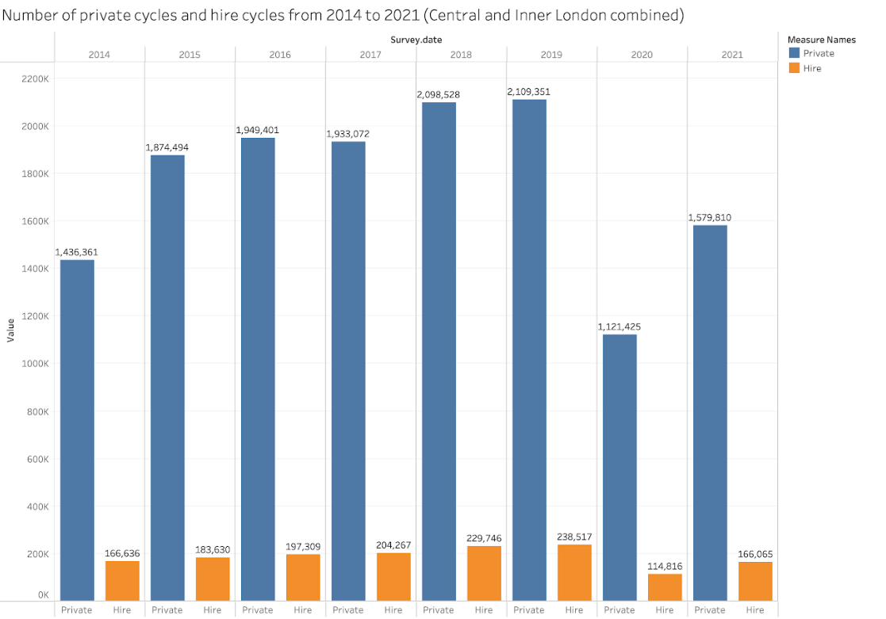
Infrastructure Analysis
Bridging the Gaps in London’s Bike Culture
Privately-owned Bikes vs
Santander Bike counts across London
Notes:
JAMES: Let’s start by looking at Privately Owned vs Santander Bike usage across London. As we look at the graph, privately owned bikes take centre stage reflecting a cultural inclination towards individual ownership.
But both privately owned bikes and the Santander bikes contribute to eco-friendly travel culture, reinforcing that Londoners’ transport behavior aligns with the broader sustainability goals of TfL.
In this light, our mission is straightforward – to explore strategies for increasing the uptake of both privately owned and Santander bikes.
Once we’ve thoroughly addressed the various factors influencing cycling uptake, we will provide recommendations to TfL. These recommendations will be accompanied by measurable progress indicators, allowing us to track the impact of our strategies over time. Our goal is not just exploration; it’s about implementing actionable solutions and gauging their effectiveness.

Slide 4
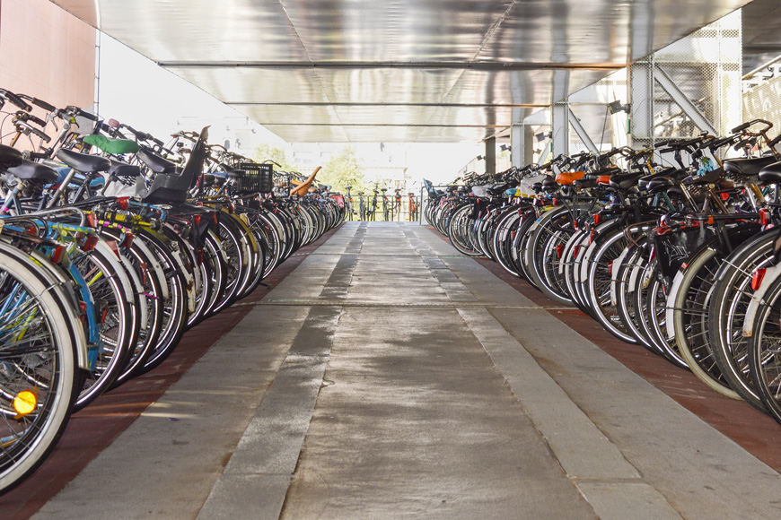
Infrastructure Analysis
Bicycle Parking
Recommendations | How to Measure Success
Enhance the capacity of bicycle parking facilities strategically across the city to accommodate growing demand. | Track usage of bicycle parking facilities and gather feedback from cyclists.
A 2019 review of scientific literature conducted by University of Leeds concluded that a lack of bicycle parking discourages cycling. ^{[1]}
In a 2016 TfL survey, 52% of respondents said it would encourage them to cycle more if their employer or place of education offered more cycle parking facilities. ^{[2]}
Notes:
KENNETH: This slide outlines our primary recommendation for increasing cycling in London through bike parking infrastructure changes.
A 2019 study by the University of Leeds found that limited access to bicycle parking hinders cycling behavior.
AND
Another study that has been done by TFL shows that 52% of Londoners are more likely to cycle with improved workplace or educational bicycle parking facilities.
We would hypothesise that there would be correlation between cycling numbers and bike parking capacities. Positive correlation with statistical significance were found as shown in the following slide.

Slide 5
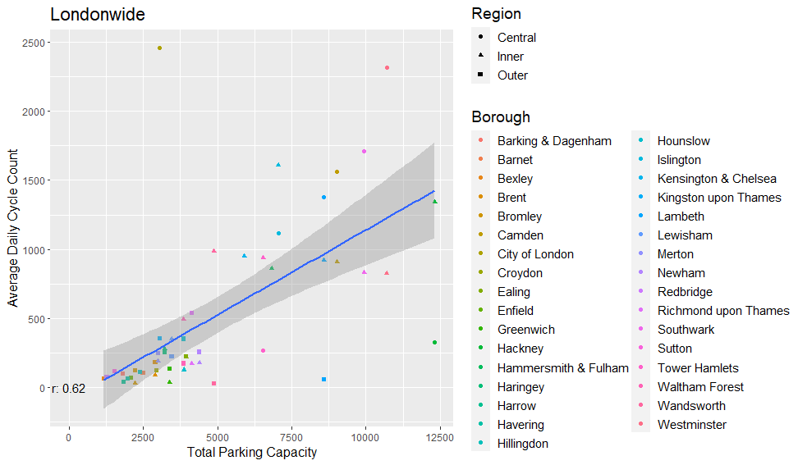
Infrastructure Analysis
Bicycle Parking Impact: A Correlation Analysis
When the relationship between bicycle parking capacity and average daily cycle counts examined, there is a statistically significant correlation with a very low p-value.
There is a high concentration of bicycle users but very limited capacity in City of London Borough.
Hackney and Lewisham, despite having ample parking, have low cycle counts.
City of London
p-value = 6.866e-07
Hackney
Lewisham
Bicycle Parking Capacity vs Daily Cycles by Borough
Correlation Co-efficient, r = 0.62, p-value = 6.866e-07
Notes:
KENNETH: To test this, we produced a graph that shows the correlation between bicycle parking capacity and daily cycles. Looking at the graph, we found out that there is a statistically significant correlation between bicycle parking capacity and average daily cycle counts with a p-value close to zero. It’s a decisive factor in choosing to cycle, emphasising the need for strategic enhancements in our city’s parking infrastructure.
We would also like to highlight that: the City of London Borough experiences a high density of bicycle users, yet available bicycle parking infrastructure remains severely constrained. In contrast, the boroughs of Hackney and Lewisham, respectively located in Central and Outer London, exhibit ample parking capacity despite having relatively low cycle counts. These outliers indicate the importance of enhancing bike parking capacities only in boroughs and locations that see shortage.

Slide 6
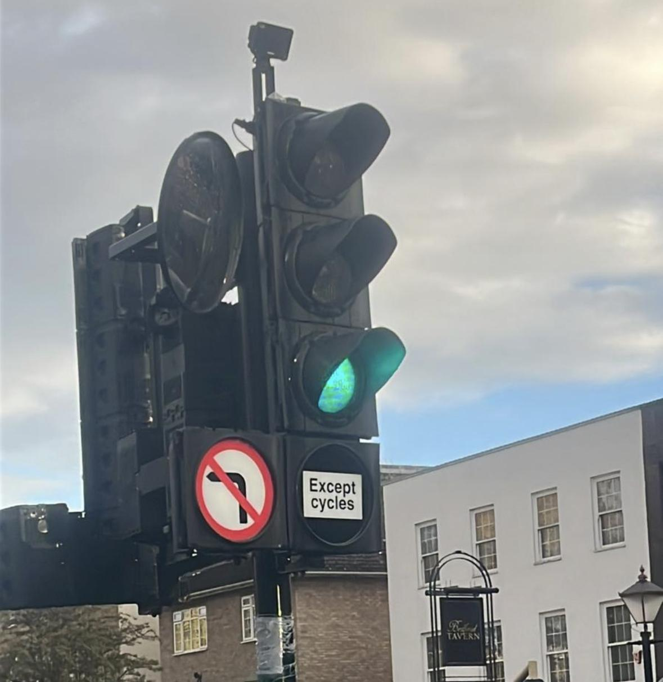
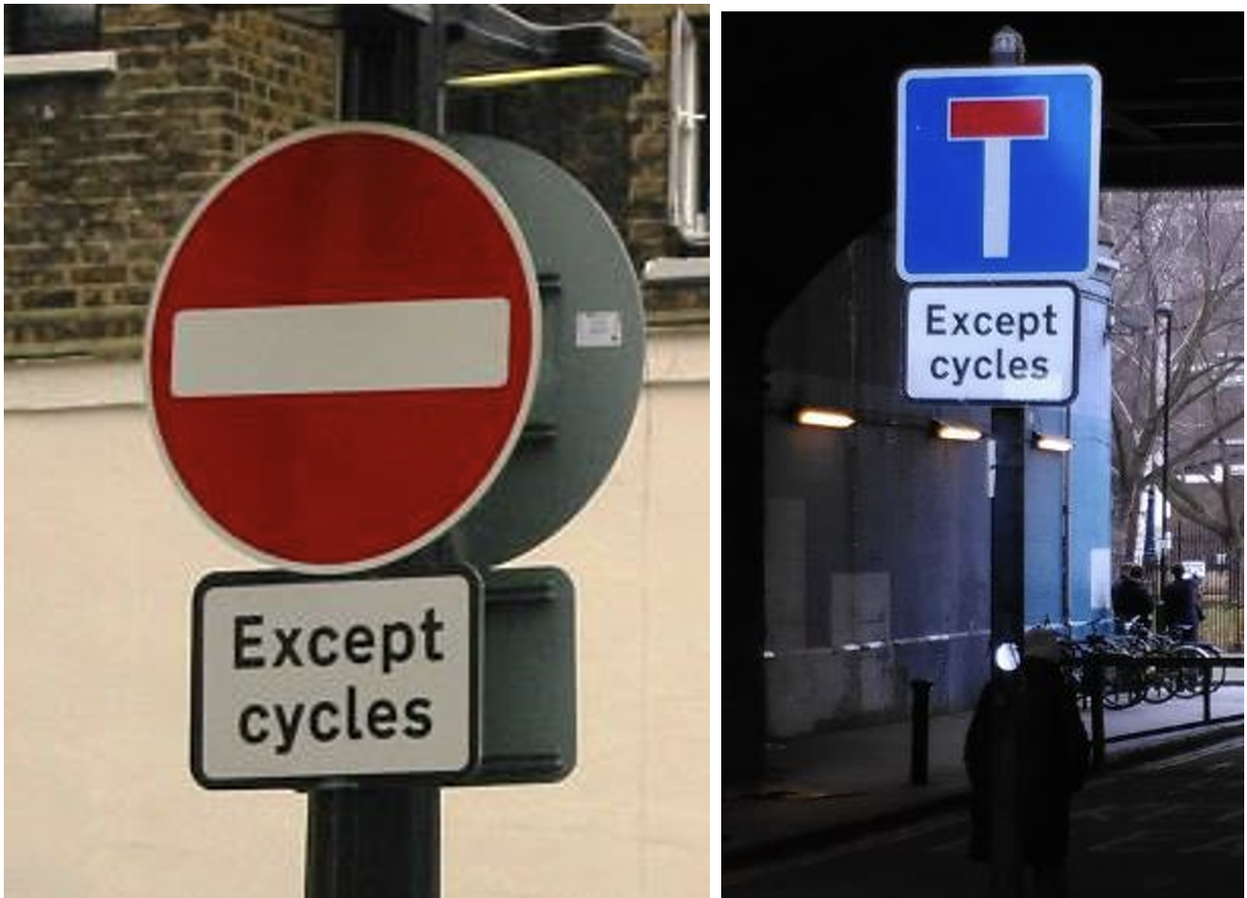
Infrastructure Analysis
Exploring the impact of Cycle Exception signposts
Recommendations | How to Measure Success
Continue to invest in safety features of the cycling infrastructure, e.g. Turning exception signposts, Except cycle signposts. | Track total cycle counts’ trend & number of ‘cycle except’ arrangement to facilitate cycling safety and gather feedback from cyclists.
The research project conducted by the Behavioural Insights Team on behalf of the Department for Transport, ‘A moment of Change: Increasing Cycling Uptake’ identified infrastructure as one of five major barriers (objectives) to be met in order for cycling rates to significantly increase.^{[3]}
In other words, people must feel safe cycling.
Good infrastructure elements such as Cycling safety and clear signages for cyclists are basic requirements for people to consider cycling as a feasible mode of transport.
Notes:
KENNETH: Next, we explored road signages that bring about road safety for cyclists.
According to A moment of Change: Increasing Cycling Update research project commissioned by the Department for Transport, infrastructure, in particular cycling safety, is one of the barriers to be addressed, or we can also frame it as one of the basic requirements to be met in order for cycling rates to significantly increase. In simple terms, people must feel safe cycling before cycling will be regarded as a feasible mode of transport. We are therefore interested in signages that bring about road safety for cyclists.

Slide 7
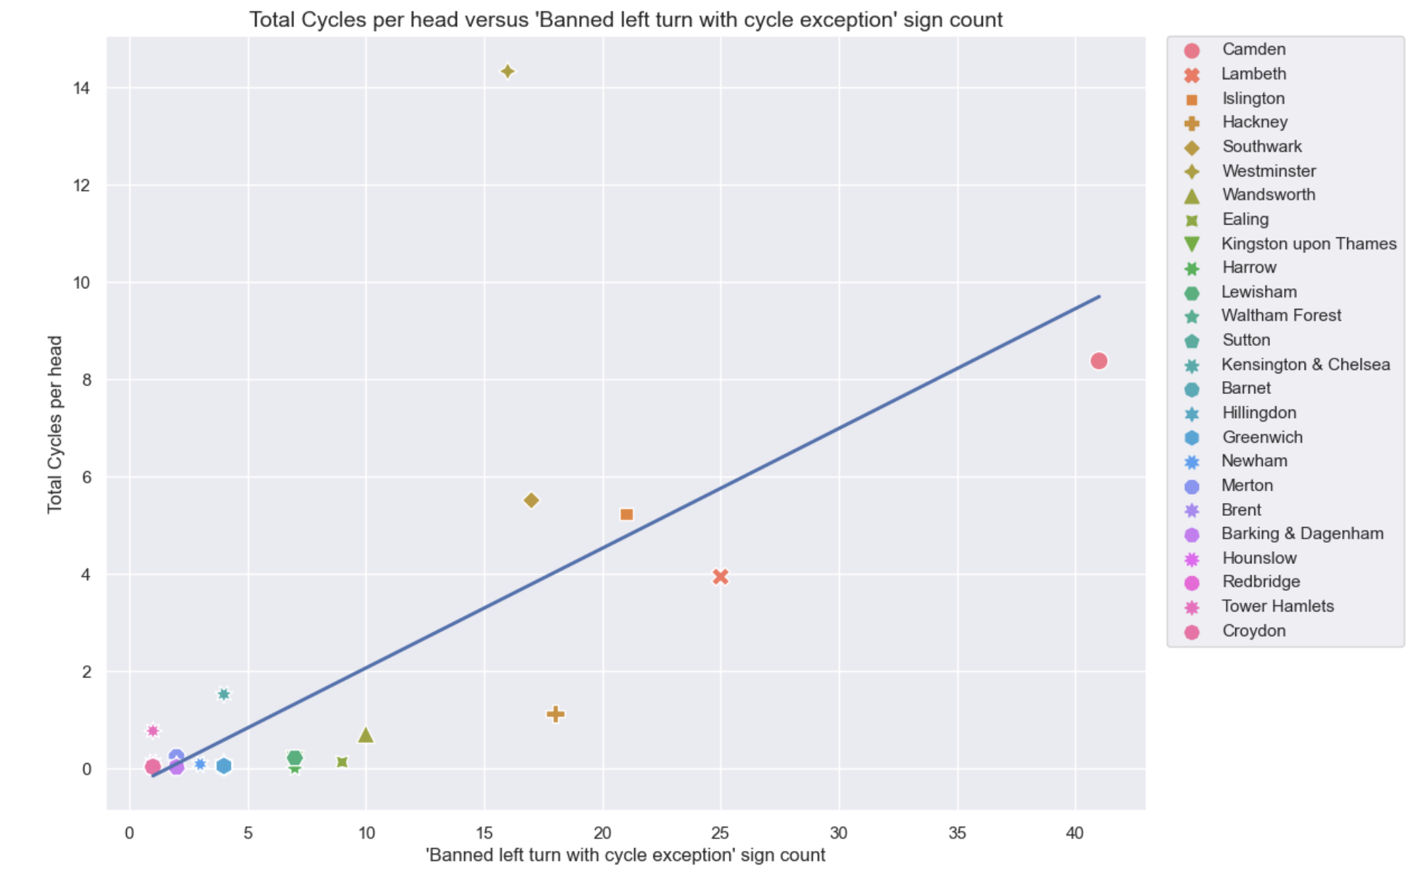
Infrastructure Analysis
Exploring the impact of ‘Banned Left Turn with Cycle Exception’ signage
R² = 48%
p-value = 0.000123
“Banned Left Turn with Cycle Exception” means vehicles are restricted from turning left at road junctions, but cycles are exempt.
Total Cyclists per head vs
‘Banned Left Turn with Cycle Exception’ sign count
Notes:
KENNETH:
According to the Asset Information Guide of the CID, Turning exceptions are where turning movements for vehicles are restricted, with accompanying signs. We are interested in banned turns where cycles are exempt as this can improve safety (e.g. by stopping cars turning in front of cycles) or allow cycles to access roads where other vehicles cannot do so. ^{[1]}
We picked the Banned Left Turn with Cycle Exception sign from the CID.
Looking at the visuals, our graph depicting Total Cyclist per head vs number of Banned Left Turn signs with Cycle Exception shows an obvious positive correlation with R-squared of 48% and statistically significant p-value of close to zero.
It indicates that more Banned Left Turn with Cycle Exception signposts is correlated with increased cycling. However, we are not saying more such cycle exception signs leads to increased cycling. Instead, these signposts have increased clarity of direction and road safety for the benefit of cyclists, thus fulfilling the basic requirement of cycling safety. There have to be other factors as well to encourage people to cycle more.
[1]: Extracted from section 3.1.10 of Asset Information Guide from the Cycling Infrastructure Database.

Slide 8
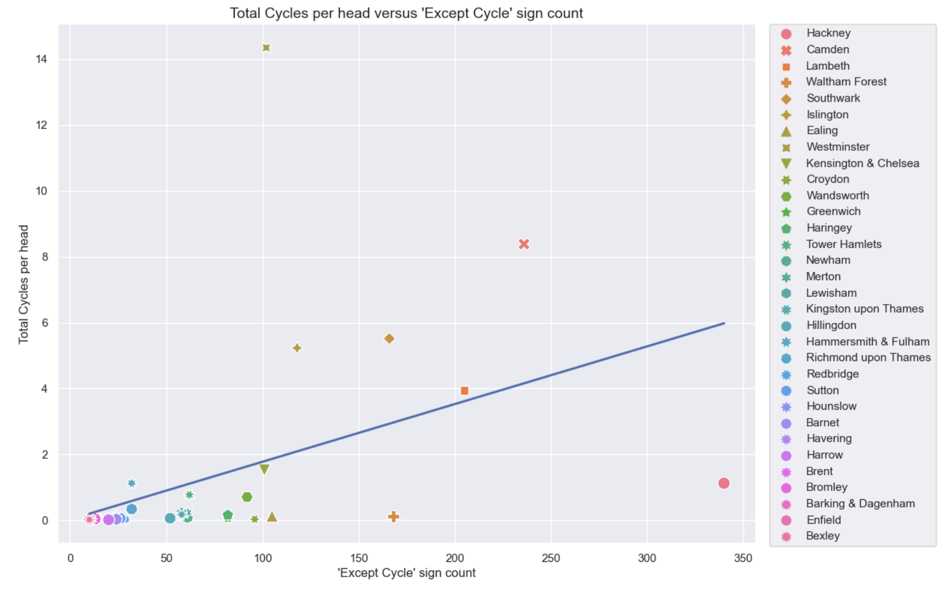
Infrastructure Analysis
Exploring the impact of ‘Except Cycles’ signage
R² = 18%
p-value = 0.0143
“Except Cycle” signs permit cycle movements that general traffic cannot make. The exception plate will always accompany another sign with a restriction. For example, the “No Entry” sign shown above has “Except cycles” beneath.
Total Cyclists per head vs Except Cycle signage count
Notes:
KENNETH: When it comes to the “Except Cycles” sign, the graph of Total Cyclists number per head vs number of “Except Cycles” sign shows a medium positive correlation which is statistically significant as well. This finding is consistent with that of the Banned Left turn sign.

Slide 9
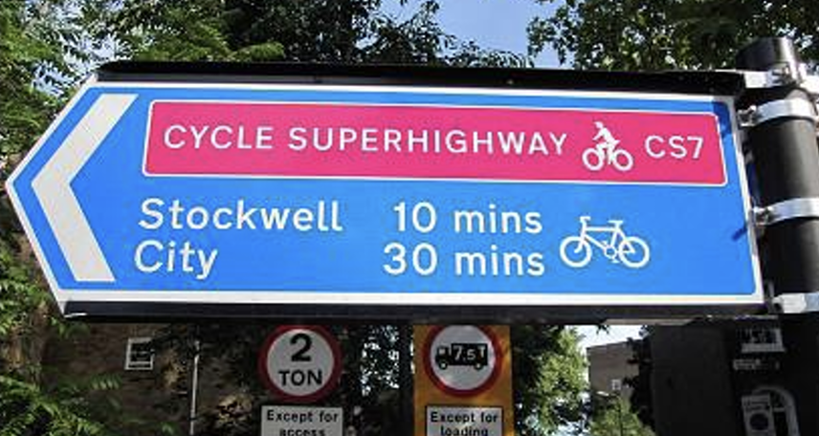
Infrastructure Analysis
Exploring the impact of Cycle Superhighways and Quietways
Recommendations | How to Measure Success
Keep monitoring utilisation and assess effectiveness of Cycle Superhighway & Quietway per location in helping increase cycling before further introducing them to other London boroughs | Track cycle counts’ trend along each Superhighway and gather feedback from cyclists.
According to TfL’s Attitudes to cycling survey 2016 ^{[2]}
Most Londoners who have used Cycle Superhighways feel they have been encouraged to cycle more
Quietways appear to have a positive impact on users’ cycling propensity
Hypothesise that there is correlation between availability of dedicated cycling paths and more cycling.
Notes:
KENNETH: In fact, we have also explored the world of Cycle Superhighways and Quietways.
According to TfL’s Attitudes to cycling survey 2016, most Londoners who have used Cycle Superhighways feel they have been encouraged to cycle more because of the Cycle Superhighways. Quietways also appear to have positive impact on their users’ cycling propensity. We therefore hypothesise that there is correlation between more cycling and more Cycle Superhighways and Quietways being available.

Slide 10
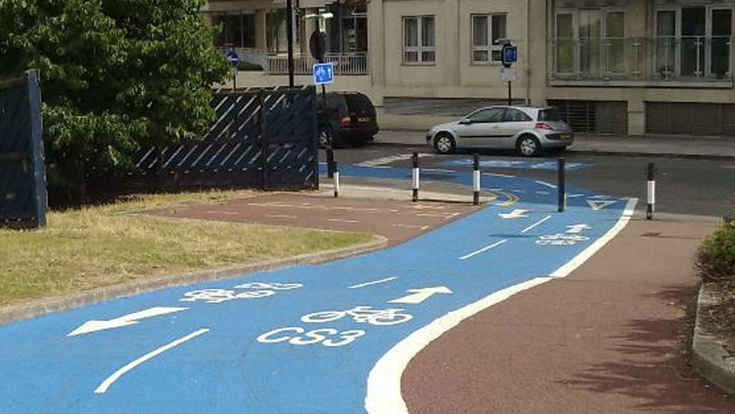
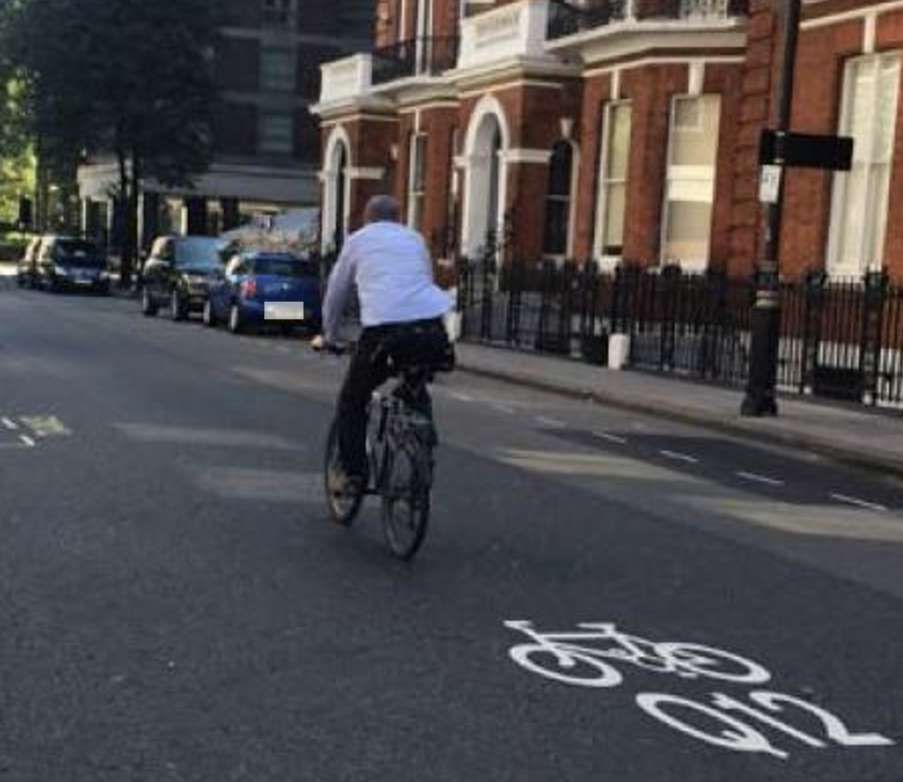
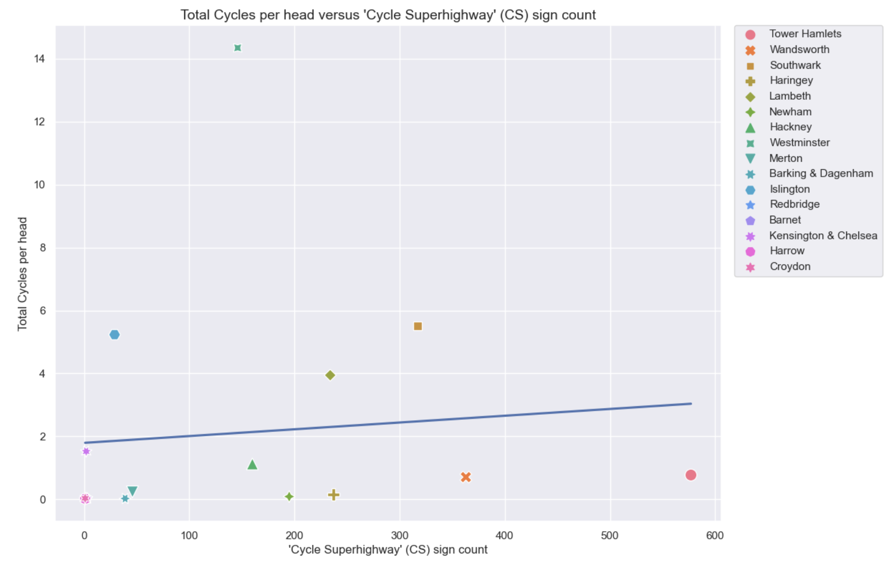
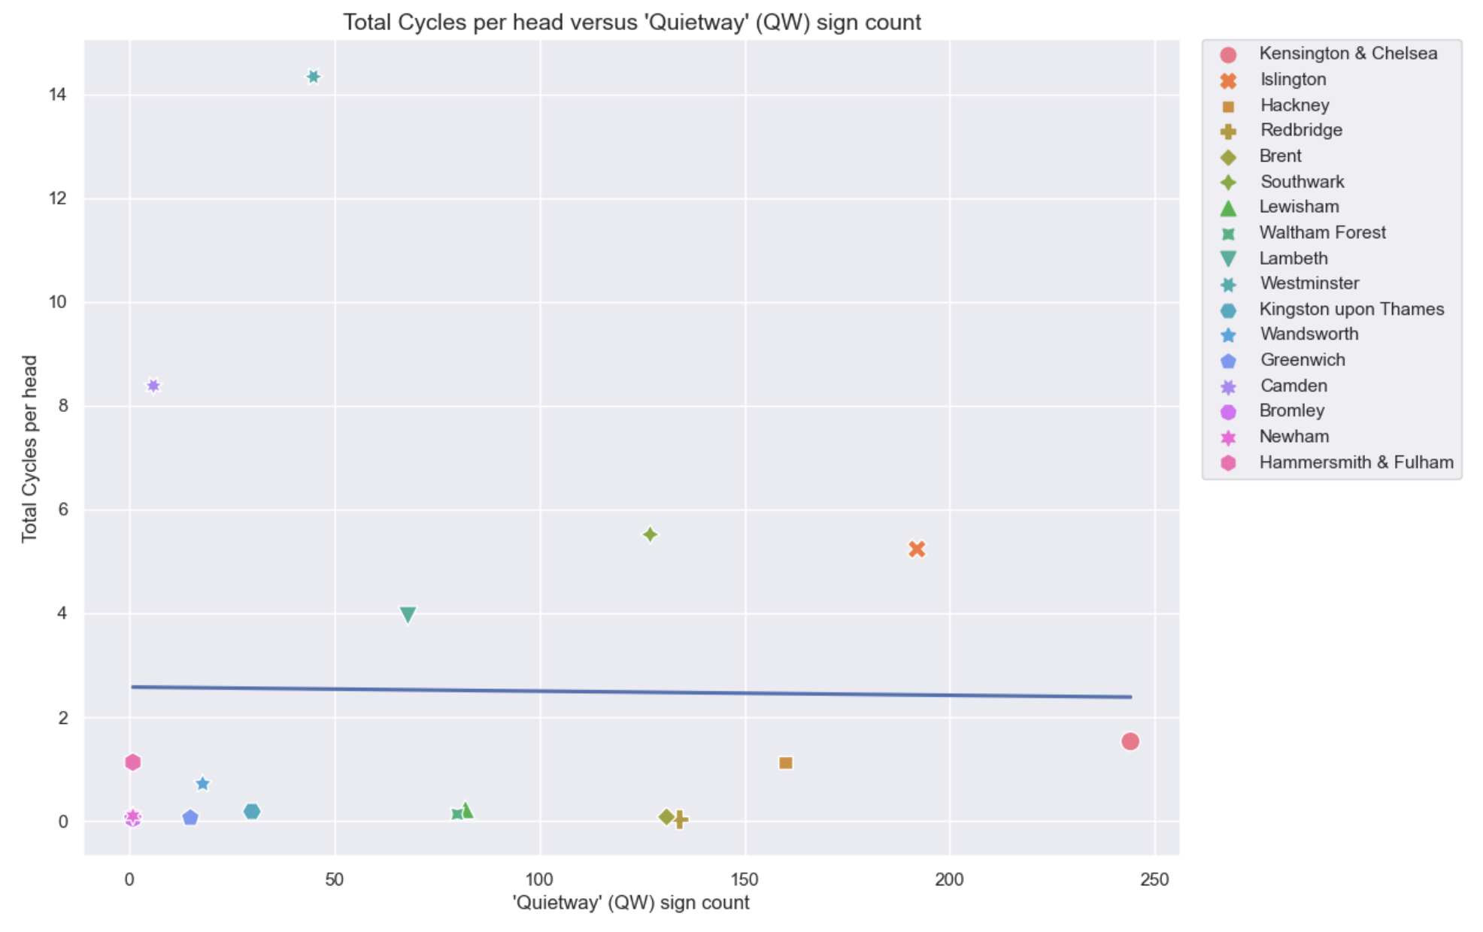
Infrastructure Analysis
Exploring Cycle Superhighways and Quietways
R² = 0.9%
p-value = 0.724
R² = 0%
p-value = 0.954
Total Cyclists per head vs
Cycle Superhighways sign count
Total Cyclists per head vs
Cycle Quietways sign count
No correlation found
Presence in only around half of London boroughs
An evidence of infrastructure alone not necessarily leading to increased cycling
Relatively new to Londoners compared to Except Cycle signposts as one of the reasons (new hypothesis to investigate and test)
Notes:
However, looking at the visuals which depict the total cyclist number per head of population vs number of signs of Cycle Superhighways in the left chart, and vs number of signs of Cycle Quietways in the right chart, there’s hardly any correlation.
Firstly we have to note that the Cycle Superhighways and Quietways are not present in every Borough, indeed, they were found only in around half of the London boroughs. Secondly, this serves as an evidence of these two infrastructure elements alone do not necessarily lead to increased cycling.
We noticed from the Attitude to Cycling Survey of 2016^{[2]}, that only 16% and 11% of Londoners have used the Cycle Superhighways and Quietways. Low usage or in order words, they being relatively new to Londoners compared to Except Cycle type of signposts may be one of many reasons why there is no correlation. This can be another hypothesis which can be further investigated and tested.
Based on current findings, however, we would recommend further assessment of the effectiveness of Cycle Superhighway & Quietway per location in helping increase cycling before further introducing them to other London boroughs
.

Slide 11
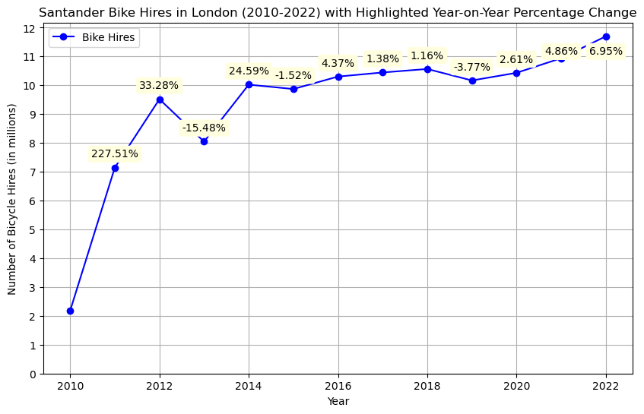
Infrastructure Analysis
Santander Cycling Uptake
Growth trajectory of Santander Cycling Uptake
Notes:
NIKITHA:
Next, we wanted to explore the uptake of Santander bikes by Londoners over the years. 2010, which was the year of their introduction saw just over 2 million rides using Santander bikes. Over the next years this number skyrocketed. When we fast forward to 2022, we hit an impressive 11.7 million rides – which is testament to the growing view people have that Santander bikes are a convenient and sustainable mode of travel. Even in the face of the Covid-19 pandemic in 2020, Santander bike usage held strong at 10.5 million rides.
Thus an integral part of increasing cycling’s share in London’s transport modes, would be focusing on Santander bikes.

Slide 12
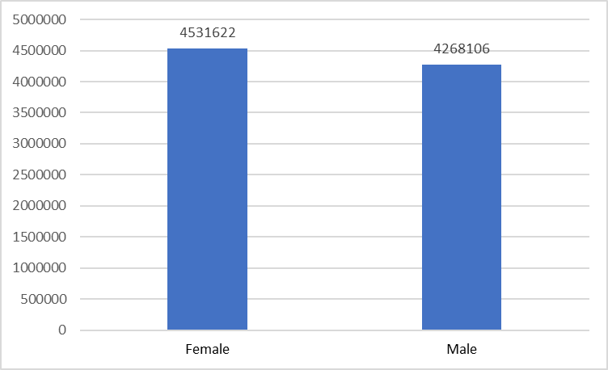
Demographic Analysis
Gender Disparity in Cycling
Female vs Male Population Count in London - 2021^{[4]}
Notes:
NIKITHA:
Moving onto our next area of analysis, we’d like to turn your attention to demographic disparities in cycling, focused on gender.
At a ratio of almost 1:1, this chart displays London's population by gender in 2021. Women in fact outnumbered men by a count of over 250,000 in the region.

Slide 13
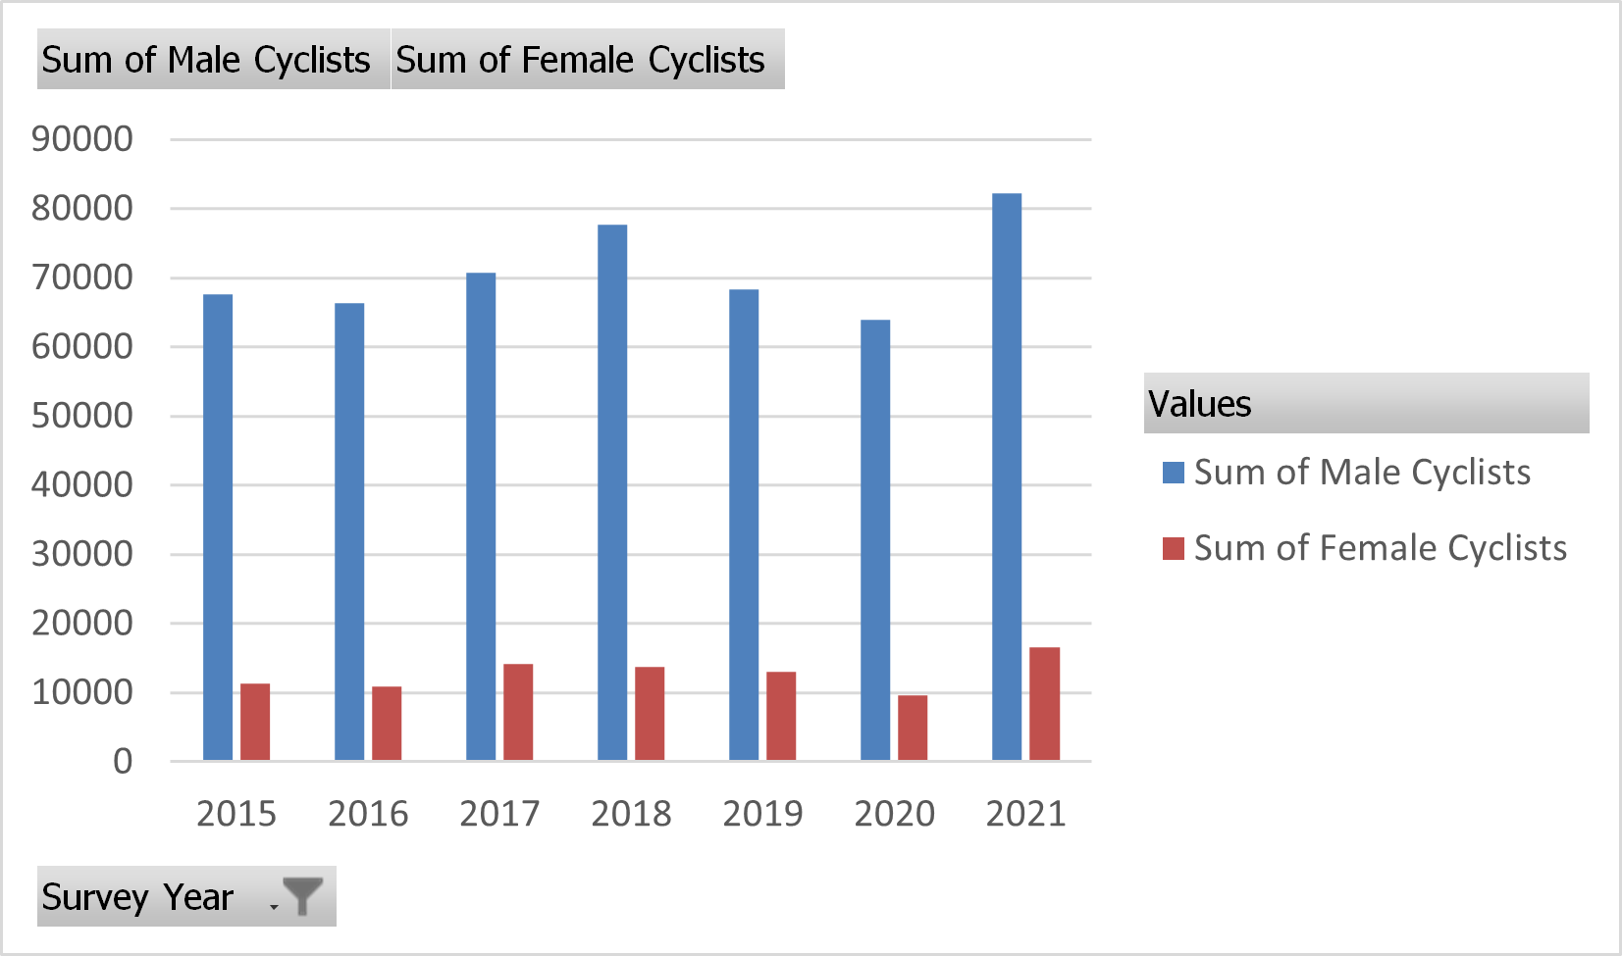
Demographic Analysis
Gender Disparity in Cycling
Number of Female vs Male cyclists in London
Notes:
NIKITHA:
However, our demographic analysis of cyclists in London paints a very different picture of gender parity.
This graph showcases the total number of cyclists per year and it reveals that women form a significantly lower share of the cycling population. In the latest data from 2021, we observe 16,563 female cyclists compared to a much larger cohort of 82,195 male cyclists. This gender gap in cycling participation sparks important considerations for targeted initiatives to make cycling inclusive and accessible
The data we used for our analysis was gathered from Outer London but reports by TfL and other organizations also find that women lag behind men significantly in cycling participation.

Slide 14
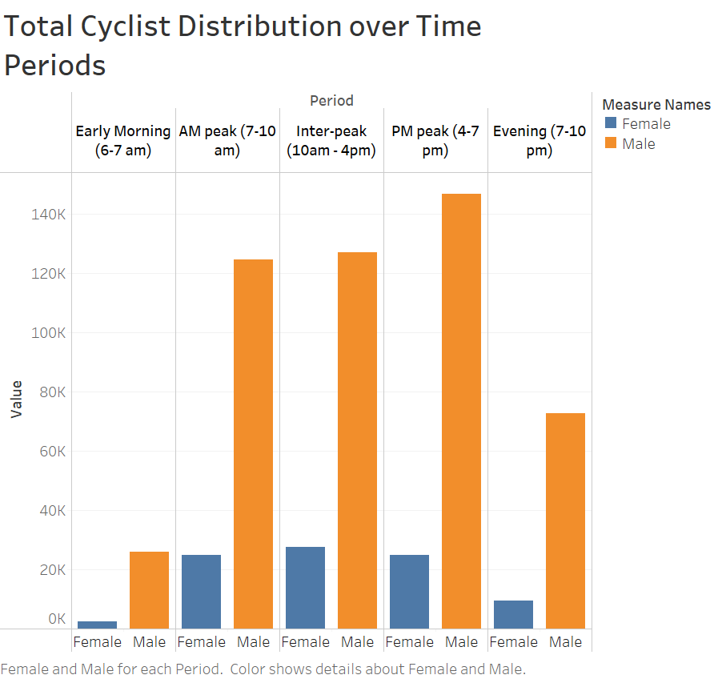
Demographic Analysis
Gender Distribution Across Time Periods
TIME PERIOD | WOMEN LIKELIHOOD TO CYCLE VS MEN
Early Morning | -2.59%
AM Peak | +2.69%
Inter Peak | +5.35%
PM Peak | -1.54%
Evening | -3.91%
Notes:
NIKITHA:
We did not find significant variability across genders based on factors like weather or days of the week. Initial hypothesis - timings for safety reasons.
Supporting this, we did observe from our data that women are more likely to cycle during Inter Peak periods, spanning from 10 am to 4 pm compared to men. And there is a relative decline in women cycling in the early mornings and late evenings compared to men.

Slide 15
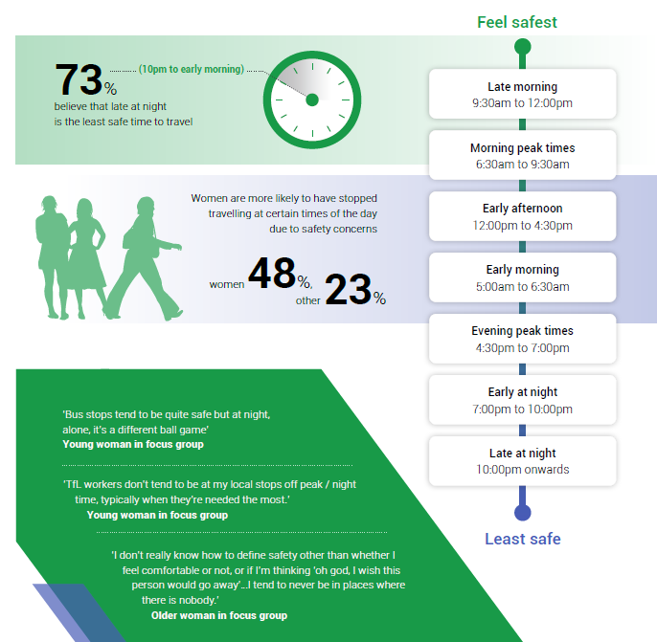
^{Image Source: [5]}
TfL 2021 Report :
“Cycling Potential in London’s Diverse Communities”
Found Road Safety and Personal Safety greatest barriers to cycling uptake
Personal Safety - greatest barrier to women, Asian and mixed ethnicity people. ^{[6]}
Notes:
NIKITHA:
This closely corresponds with the times people were found to feel relatively unsafe in a 2022 report by London TravelWatch on Personal Security among cyclists, as you can see on the left of this slide. Women were found significantly likely to avoid traveling at certain times for safety reasons.
The importance of Personal Safety is also corroborated by TfL’s report on Cycling Potential in London’s Diverse Communities which found that Road Safety and Personal Safety were the top barriers to cycling, but Personal Safety was specifically the top concern for women.

Slide 16
Recommendations | How to Measure Success
Implement safety alarms or alert systems connected to rented bike to enhance personal security. | Measured by tracking incident reduction and assessing overall increase in safety perceptions among female cyclists.
Increase the presence of TfL staff at docking stations to ensure a swift response to queries, maintenance issues, and enhance overall safety. | A noticeable decrease in query response time from TfL and improved customer satisfaction among female cyclist.
Introduce safety lockers at docking stations to provide a secure space for personal belongings. | Availability and utilisation of lockers, feedback on their convenience, and decrease in reported property-related concerns.
Notes:
NIKITHA:
Keeping the concept of Personal Safety and Security at the forefront, in order to reduce the gender gap in cycling, we’ve suggested a set of recommendations including implementing better reporting and alert systems connected to bikes, safety lockers at docking stations and increased TfL staff presence.

Slide 17
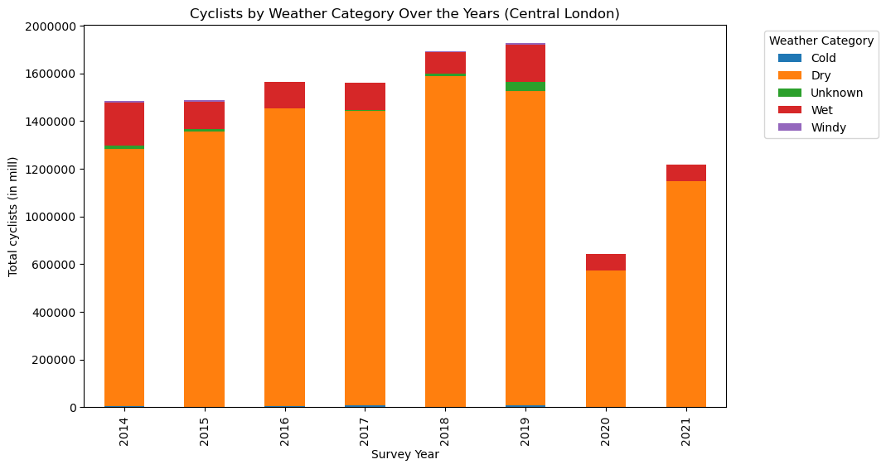
Weather Analysis
Unlocking Cycling Patterns: Weather Insights
Recommendations | How to Measure Success
Promote weather-resilient cycling infrastructure and implement incentive programs to reward cyclists for choosing sustainable transportation, even in adverse weather^{[7]}. | Monitor usage of covered bike parking spaces and track cyclist participation in incentive programs.
Notes:
JAMES: We next analysed how cycling patterns are affected by weather. The data shows that Londoners prefer cycling in dry weather, confirming the link between favourable conditions and increased cycling.
Another compelling observation from this dataset was the substantial decline in cycling activity within Central London when the pandemic hit in 2020. This can be attributed to the stringent lockdown measures imposed in Central London, coupled with the notable concentration of offices. As the workforce transitioned to remote work, eliminating the need for daily commutes, the urban landscape experienced a perceptible shift in cycling dynamics. Alongside this, the virus spreads much quicker in densely populated areas.
As shown, in the table, we have provided a list of recommendations including investing in weather-resilient infrastructure and introducing incentive programs that reward cyclists for choosing sustainable transportation options.

Slide 18

Further Exploration: Revolutionising Urban Cycling by Converting Disused Tube Stations into Dedicated Cycle Routes ^{[6]}
40 stations disused and available for repurposing
Enhanced connectivity
Improved safety
Weather resilience for cyclists in London
Notes:
JAMES: As we come to the end of our presentation, we wanted to suggest an exciting idea for exploration– converting disused tube stations into dedicated cycle routes. This unconventional concept addresses safety concerns, weather-related challenges, and promotes transport efficiency. With over 40 stations available for repurposing, we envision creating a comprehensive cycling network, fostering enhanced connectivity between neighbourhoods, business districts, and popular destinations.

Slide 19
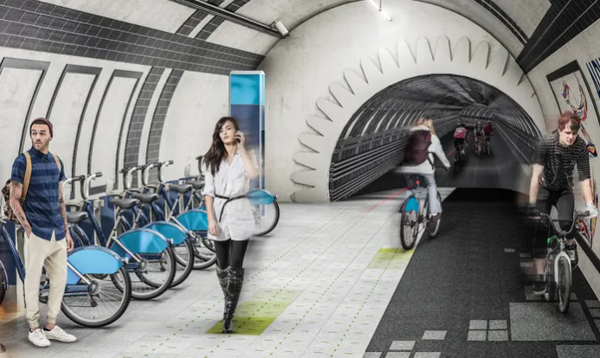
Further Exploration: Revolutionising Urban Cycling by Converting Disused Tube Stations into Dedicated Cycle Routes
Feasibility and Viability
Historical Records
Cost-Benefit Analysis
Public acceptance
Demographic data
Integration with existing infrastructure
Notes:
JAMES: To assess the the feasibility and viability of repurposing these tubs tunnels, we’d need to analyse historical records and provide cost estimates which would guide us in understanding the structural aspects and financial implications. Next, we’d assess public acceptance and usage. Demographic data and public opinion surveys would help identify potential users and gauge public sentiment. Integration with existing infrastructure is crucial. Geographic and usage data would inform us about suitable connection points and accessibility. This forward-thinking approach reflects our commitment to revolutionising urban cycling in London and creating a more cyclist-friendly cityscape.

Slide 20
Thank you for your attention. Any questions?
Notes:
JAMES: Thank you for your attention. Any questions?

Slide 21
Appendix Slides
TEAM CLOUD 9
Monday 20th November 2023

Slide 22
Cycling Infrastructure Recommendations (1/2)
Research / Data insights | Recommendations | How to Measure Success
Lack of bike parking discourages cycling / Statistically significant correlation between bicycle parking capacity and average daily cycle counts with a p-value close to zero | Enhance the capacity of bicycle parking facilities strategically across the city to accommodate growing demand. Collaborate with public transport authorities to integrate bike parking facilities seamlessly with transit hubs. | Monitor the frequency and capacity usage or enhanced bike parking facilities, and regularly collect feedback from cyclists regarding the satisfaction with the new bike parking spaces. A successful outcome would involve an increase in the number of bikes parked daily and a positive sentiment reflected from users.
People must feel safe cycling / Cycle exception signage counts’ statistically significant correlation with Total cycles per head | Continue to invest in safety features of the cycling infrastructure, e.g. Turning exception signposts, Except cycle signposts. | Track total cycle counts’ trend & number of ‘cycle except’ arrangement to facilitate cycling safety and gather feedback from cyclists.
Only 16% of Londoners in Sept 2016 have used Cycle Superhighways / Presence of Superhighways does not correlate with more cycling | Keep monitoring utilisation and assess effectiveness of Cycle Superhighway & Quietway per location in helping increase cycling before further introducing them to other London boroughs. | Track cycle counts’ trend along each Superhighway and gather feedback from cyclists.
Notes:
NIKITHA:
This slide outlines our primary recommendations for increasing cycling in London through infrastructure changes. These include enhancing bike parking, promoting the benefits of using Cycle Superhighways and Quietways, and strategies to boost Santander Cycling.
Each of our recommendations also includes a metric for its success. But in the interest of time…

Slide 23
Cycling Infrastructure Recommendations (2/2)
Research / Data insights | Recommendations | How to Measure Success
Growth trend in Santander Bike hire | Launch targeted Santander Bike campaigns to rekindle interest and promote their benefits. Foster partnerships and engagement with local communities to understand preferences and barrier. Introduce incentive programs such as discounts or loyalty rewards for frequent Santander bike users. | Measure the frequency of Santander bike rides over time. Evaluate community engagement levels through event participation and survey responses. Track the uptake of incentive programs. Success will be reflected by increased ride frequency, positive sentiment from the community, and increased participation in incentive programs.

Slide 24
Demographic Recommendations
Recommendations | How to Measure Success
Implement safety alarms or alert systems connected to rented bike to enhance personal security. | Measured by tracking incident reduction and assessing overall increase in safety perceptions among female cyclists.
Increase the presence of TfL staff at docking stations to ensure a swift response to queries, maintenance issues, and enhance overall safety. | A noticeable decrease in query response time from TfL and improved customer satisfaction among female cyclist.
Introduce safety lockers at docking stations to provide a secure space for personal belongings. | Availability and utilisation of lockers, feedback on their convenience, and decrease in reported property-related concerns.

Slide 25
Weather Recommendations
Recommendations | How to Measure Success
Promote weather-resilient cycling infrastructure and implement incentive programs to reward cyclists for choosing sustainable transportation, even in adverse weather^{[7]}. | Monitor usage of covered bike parking spaces and track cyclist participation in incentive programs.

Slide 26
References
Heinen, E., & Buehler, R. (2019). Bicycle parking: a systematic review of scientific literature on parking behaviour, parking preferences, and their influence on cycling and travel behaviour. Transport Reviews, 39(2), 198-220
https://eprints.whiterose.ac.uk/143013/1/Bicycle%20parking%20paper%20revision3%20final.pdf
Attitudes towards cycling. (2016). Transport for London. https://content.tfl.gov.uk/attitudes-to-cycling-2016.pdf
A Moment of Change: Increasing Cycling Uptake By Department of Transport (2020): https://assets.publishing.service.gov.uk/government/uploads/system/uploads/attachment_data/file/1005208/moment-of-change-increasing-cycling-uptake.pdf
Sex - Census 2021. (2021). Office for National Statistics. https://www.ons.gov.uk/datasets/TS008/editions/2021/versions/4/filter-outputs/9beb3fac-22bb-46ce-81b3-01e50a8e969e#get-data
Personal Security on London’s Transport Network. (2022). London TravelWatch
https://www.londontravelwatch.org.uk/wp-content/uploads/2022/01/Personal-security-on-Londons-Transport-network.pdf
Cycling potential in London’s diverse communities. (2021). Transport for London.
https://content.tfl.gov.uk/cycling-potential-in-londons-diverse-communities-2021.pdf
Analysis of Cycling Potential 2016 (2016), https://content.tfl.gov.uk/analysis-of-cycling-potential-2016.pdf
Bike paths in abandoned tube tunnels: is the London Underline serious: https://www.theguardian.com/cities/2015/feb/05/bike-paths-abandoned-tube-tunnels-london-underline

